Slide 1
Community Based Interventions for Eligibility and Suicide Prevention:
Community Engagement and Partnerships Program
VA Office of Mental Health and Suicide Prevention (OMHSP)
Suicide Prevention Program
Cleared for External updated September 2021

Slide 2
Overview
Suicide Prevention: A Public Health Issue
Suicide Prevention: Key Data
Suicide Prevention 2.0 Public Health Strategy
Suicide Prevention 2.0 Community Based-Interventions for Suicide Prevention (CBI-SP)
Community Engagement and Partnerships Program
Eligibility Determination
Benefits
VHA Suicide Prevention Resources

Slide 3
Suicide Prevention: A Public Health Issue

Slide 4


Slide 5
Suicide as a National Problem
Suicide is a national issue, affecting both the Veteran and general population.
Societal factors, such as economic disparities, race/ethnicity/LGBT disparities, homelessness, social connection and isolation, and health and well-being, play additional roles in suicide.
Coronavirus Disease 2019 (COVID-19) pandemic has also placed additional strain on our Nation and on individuals and communities.
One suicide is heartbreaking, notably affecting an estimated 135 surviving individuals for each death by suicide.
Our nation grieves with each suicide, necessarily prompting the collective tireless pursuit of evidence-based clinical interventions and community prevention strategies, critical to the implementation of VA’s National Strategy for Preventing Veteran Suicide.
Notes:
Facilitator Notes:
Suicide is a national public health issue. VA has made suicide prevention a top clinical priority and is implementing a comprehensive public health approach to reach all Veterans — including those who do not receive VA benefits or health services.
Sources:
Cerel, J., Brown, MM., Maple, M., Singleton, M., van de Venne, J, Moore, M., & Flaherty, C., How many people are exposed to suicide? Not six. Suicide and Life-Threatening Behavior, (2018) https://doi.org/10.1111/sltb.12450
Turecki, G., Brent, D.A. (2016) Suicide and suicidal behavior. Lancet. 387:12271,227–39.
Zalsman G., Hawton, K., Wasserman, D., van Heeringen, K., Arensman, E., Sarchiapone, M., … Zohar, J. (2016) Suicide prevention strategies revisited: 10-year systematic review. Lancet. 3:646–59.
Department of Veterans Affairs (2018). National Strategy for Preventing Veteran Suicide. Washington, DC. Available at https://www.mentalhealth.va.gov/suicide_prevention/docs/Office-of-Mental-Health-and-Suicide-Prevention-National-Strategy-for-Preventing-Veterans-Suicide.pdf.
Resource:
https://www.mentalhealth.va.gov/docs/data-sheets/2020/2020-National-Veteran-Suicide-Prevention-Annual-Report-11-2020-508.pdf
https://www.cdc.gov/violenceprevention/suicide/fastfact.html
CDC. Web-based Injury Statistics Query and Reporting System (WISQARS). (2020) Atlanta, GA: National Center for Injury Prevention and Control. https://www.cdc.gov/injury/wisqars/index.html
Substance Abuse and Mental Health Services Administration. (2019) Key substance use and mental health indicators in the United States: Results from the 2018 National Survey on Drug Use and Health (HHS Publication No. PEP19-5068, NSDUH Series H-54). Rockville, MD: Center for Behavioral Health Statistics and Quality, Substance Abuse and Mental Health Services Administration. Retrieved from https://www.samhsa.gov/data/

Slide 6
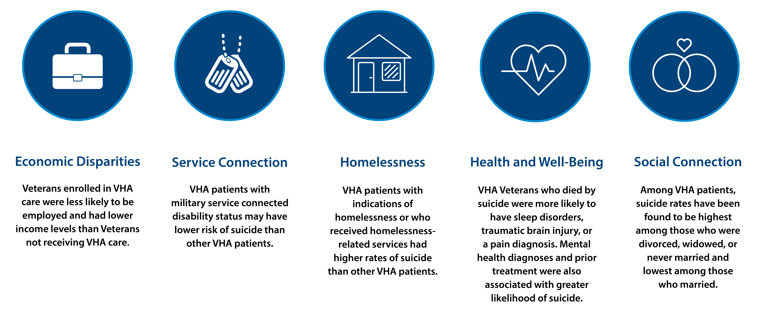
Veteran VHA Users Have Unique Experiences
Notes:
Facilitator Notes:
Veteran VHA users have a broad range of unique experiences, including:
Economic Disparities: Veterans enrolled in VHA were less likely to be employed and had lower income levels than Veterans not receiving VHA Care.
Service Connection: VHA Patients with military service-connected disability status may have lower risk or suicide than other VHA patients.
Homelessness: VHA patients with indications of homelessness or who received homelessness-related services had higher rates of suicide than other VHA patients.
Health & Well-being issues: VHA Veterans who died by suicide were more likely to have sleep disorders, traumatic brain injury or a pain diagnosis, mental health diagnosis and prior treatment were also associated with greater likelihood of suicide.
Social Connection: Among VHA patients, suicide rates have been found to be highest among those who were divorced, widowed, or never married and lowest among those who married.
These unique experiences are highlighted, as they can put Veterans at greater risk for suicide. As VHA staff, we assist with questions about treatment options, linkage to community resources to promote social connection, help with housing, employment, and the service connection process.
Sources & Resources:
Community Based Interventions for Suicide Prevention (CBI-SP) Training Academy (PPT Presentation). Office of Mental Health and Suicide Prevention.

Slide 7
Suicide Prevention: Key Data

Slide 8
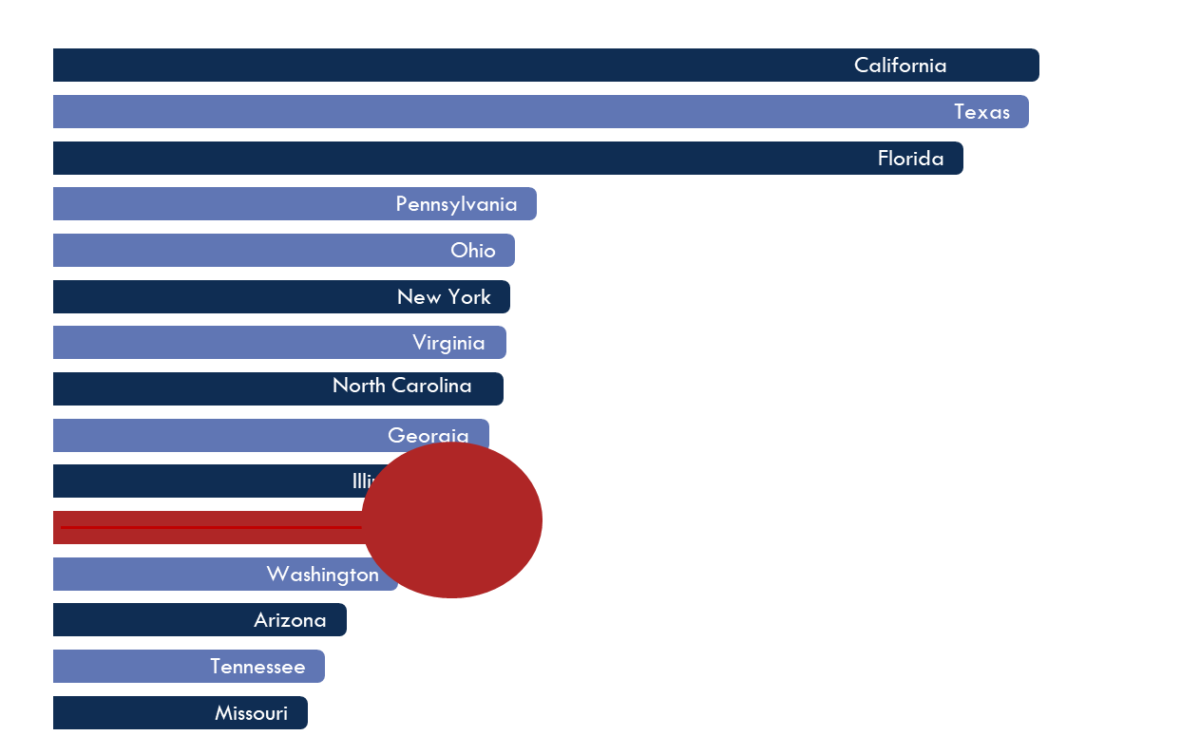
Veteran population in Michigan
Michigan has one of the largest Veteran populations in the country, ranking 11th in 2020 with over 567,000 Veterans
Michigan

Slide 9
251,418 total Michigan VHA enrollees in 2020 (~ 16,729 women Veterans)
  Ann Arbor- 60,260
  Battle Creek- 57,500
  Detroit – 65,534
  Saginaw – 43,387
  Iron Mt – 24,737
~315,000 not connected to VHA

Slide 10

2021 National Veteran Suicide Prevention Annual Report
Annual Report
  Reports on trends in Veteran suicide deaths from 2001-2019
  Focuses on suicide counts and rates among various Veteran subpopulations
State Data Sheets
  Examines state-level Veteran suicide deaths and compares to national and regional trends
  53 data sheets available for all 50 states, D.C., Puerto Rico, and U.S. territories
Access the reports online:
www.mentalhealth.va.gov/mentalhealth/suicide_prevention/data.asp
Notes:
Facilitator Notes:
Suicide data, such as that presented in the 2020 National Veteran Suicide Prevention Annual Report, is an integral part of VA’s public health strategy and enables VA to tailor suicide prevention initiatives for different populations.
This year’s report suggests that the steps the VA has taken to prevent suicide have made an impact. However, there is still much work to be done.
VA continues to reach out to our nation’s health systems and communities to build a network that can benefit both Veterans and the general public.
The report uses the most recent and comprehensive information regarding Veteran suicide, including data updates from the Department of Defense and Centers for Disease Control and Prevention and regarding the Veteran population, using VetPop2018. Consequently, the present report provides the definitive current information on Veteran suicide from 2005-2018.
As part of VA’s 2020 National Veteran Suicide Prevention Annual Report, VA has released its state-level suicide data, analyzing Veteran suicide data for all 50 states, the District of Columbia, Puerto Rico, and the U.S. island territories. Collectively, the state data sheets underscore the fact that suicide is a serious public health concern that affects communities in every state.
These state data sheets are part of VA’s comprehensive analysis of Veteran suicide data from 2005 to 2018. In the analysis, VA examined suicide rates for Veterans and non-Veterans, and drew comparisons between the groups.

Slide 11
Veteran Suicide Deaths, 2001-2019
In 2019, the number of Veteran suicides (6,261) was the lowest since 2007.
Notes:
6,261 Veterans died by Suicide in 2019 compared with 6,660 in 2018
Veterans accounted for 5,989 suicides in 2001, which represented 20.2% of suicides among U.S. adults in 2001; and 6,261 suicides in 2019, which, by comparison, represented 13.7% of suicides among U.S. adults in 2019. Veterans ages 55-74 were the largest population subgroup; they accounted for 38.4% of Veteran suicide deaths in 2019.

Slide 12
Age and Sex-Adjusted Suicide Rates,
Veterans and Non-Veteran US Adults, 2001-2019
From 2018 to 2019, changes in age- and sex-adjusted suicide mortality rates: Veterans - 7.2% decrease, Non-Veteran US adults - 1.8% decrease
From 2001 through 2019, adjusted suicide rates among Veterans
were greater and rose faster than for non-Veteran US adults.
Notes:
From 2018 to 2019, changes in age- and sex-adjusted suicide mortality rates: Veterans - 7.2% decrease, Non-Veteran US adults - 1.8% decrease
From 2001 to 2019, the U.S. non-Veteran adult population increased 26.2%, from 186.6 million in 2001 to 235.4 million in 2019. From 2001 to 2019, the Veteran population decreased 23.1%, from 25.7 million in 2001 to 19.8 million in 2019. In this context, from 2001 to 2019, the unadjusted suicide rate among non-Veteran U.S. adults rose 33.0%, from 12.6 per 100,000 in 2001 to 16.8 per 100,000 in 2019. In comparison, the rate among Veterans rose 35.9% from 2001 to 2019, from 23.3 per 100,000 in 2001 to 31.6 per 100,000 in 2019.
In 2019, the unadjusted suicide rates were highest among Veterans ages 18-34 (44.4 per 100,000). The unadjusted rate decreased 12.8% for female Veterans in 2019 compared to 2018, and decreased 3.6% for male Veterans in 2019 compared to 2018. To account for a) differences between the non-Veteran U.S. population and the Veteran population in terms of age and sex, and b) differences across time within the Veteran population, age- and sex-adjusted suicide rates were calculated. Figure indicates that the difference in adjusted rates between Veterans and non-Veterans was highest in 2017, when Veteran adjusted rates were 66.3% greater than those for non-Veteran adults; this differential decreased to 52.3% in 2019

Slide 13
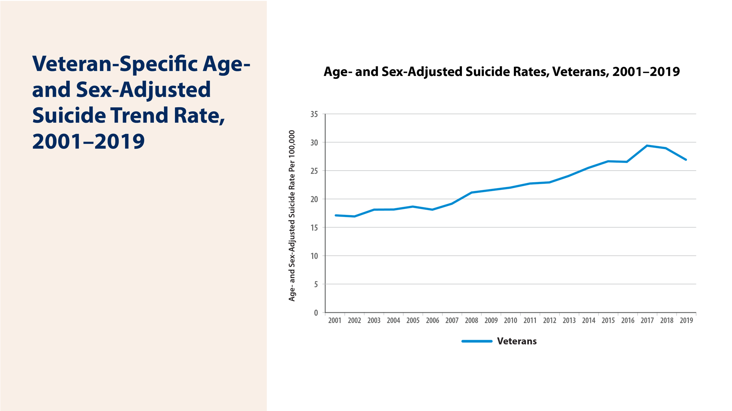
Veteran-Specific Age- and Sex-Adjusted Suicide Rates,
2001-2019
The Age and Sex-Adjusted Suicide Rate decreased 7.2% percent in 2019 compared to 2018
This is a decrease from 29.0 Veteran suicides per 100,000 in 2018 to 26.9 Veteran suicides per 100,000 in 2019.
Notes:
Despite these decreases, Veterans continued to have a greater suicide risk. Age- and sex-adjusted suicide rates were 52.3% higher among Veterans than non-Veteran US adults. The difference in adjusted rates between Veterans and non-Veteran US adults was highest in 2017 with a difference of 66.3%.

Slide 14
In 2019, adjusted suicide rates were 152% greater for Veteran men than Veteran women.
Notes:
Rates for Veteran men were highest in 2018 (40.4/100,000) and fell 3.8% in 2019 (38.8/100,000)
Rates for Veteran women were highest in 2017 (19.9/100,000) and fell in 2018 (18.1/100,000) and again in 2019 (15.4/100,000), which represented a 14.9% decrease relative to 2018.
From 2018 to 2019, there was a 7.2% overall decrease in the age- and sex-adjusted Veteran suicide mortality rate in 2019, while among non-Veteran US adults, the adjusted suicide mortality rate fell by 1.8%.
The age-adjusted suicide rate for male Veterans decreased 3.8% in 2019 from 2018 while the age-adjusted suicide rate for female Veterans decreased 14.9% in 2019 from 2018.

Slide 15
In 2019, suicide rates were highest among Veterans who were White
and lowest among Veterans who were Black or African American.
Notes:
In 2019, suicide rates were highest among Veterans who were White (33.6/100,000) and lowest among Veterans who were Black (14.5/100,000).

Slide 16
Methods of suicide
Firearms are the most lethal method of suicide.
Firearms are 85-90% lethal when used during a suicide attempt. It is very important to address firearms with every situation/every time to ensure that access is address.
All other methods combined are 5% lethal when used during a suicide attempt.
Veterans are trained to handle/use weapons.
Veterans usually have access to firearms; some have a collection of firearms.

Slide 17
Suicide Deaths, Methods Involved, 2019 and Change from 2001
 | Non-Veteran |  |  |  | Non-Veteran |  | Veteran
 | U.S. Adults |  | Veterans |  | Women |  | Women
 | 2019 | Change* | 2019 | Change* | 2019 | Change* | 2019 | Change*
Firearms | 47.9% | (-4.8%) | 69.2% | (+2.7%) | 31.3% | (-4.2%) | 49.8% | (+12.8%)
Poisoning | 13.9% | (-4.5%) | 8.4% | (-4.8%) | 31.0% | (-7.1%) | 26.3% | (-16.6%)
Suffocation | 29.6% | (+8.8%) | 16.9% | (+2.9%) | 27.7% | (+12.0%) | 20.5% | (+10.1%)
Other | 8.7% | (+0.6%) | 5.4% | (-0.9%) | 10.0% | (-0.7%) | 3.4% | (-6.3%)
Non-Veteran |  | Veteran
Men |  | Men
2019 | Change* | 2019 | Change*
53.0% | (-5.0%) | 70.2% | (+2.9%)
8.5% | (-3.8%) | 7.5% | (-4.9%)
30.2% | (+7.9%) | 16.8% | (+2.7%)
8.3% | (+1.0%) | 5.5% | (-0.8%)
* Change Versus Among Suicide Decedents in 2001
Veteran suicides were more likely to involve firearms. This difference increased from 2001 to 2019.
Notes:
Among non-Veterans overall, there were increases from 2001 to 2019 in the percentage of suicides involving suffocation and “other means” and decreases in the percentage involving firearms and poisoning.
Among Veterans, there were increases in the percentage involving firearms and suffocation and decreases for those involving poisoning and other means.
Firearms accounted for 70.2%of male Veteran suicides in 2019 (up from 69.6% in 2018) and 49.8%of Female Veteran suicides in 2019 (up from 41.1% in 2018). The proportion of firearm-related Veteran suicide deaths increased in 2019 compared to 2001.

Slide 18
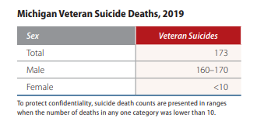

Slide 19
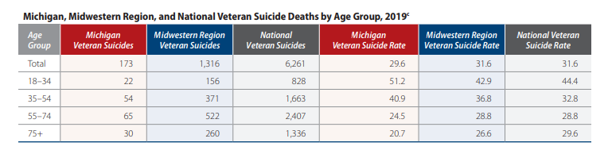

Slide 20
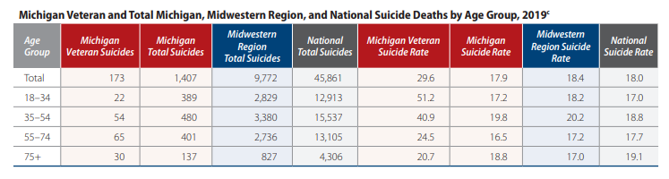

Slide 21
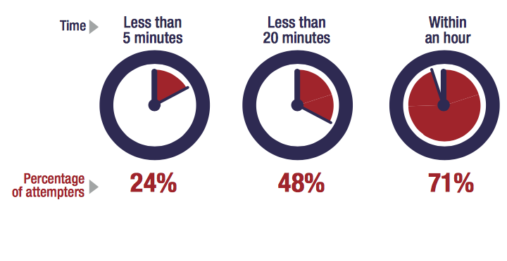
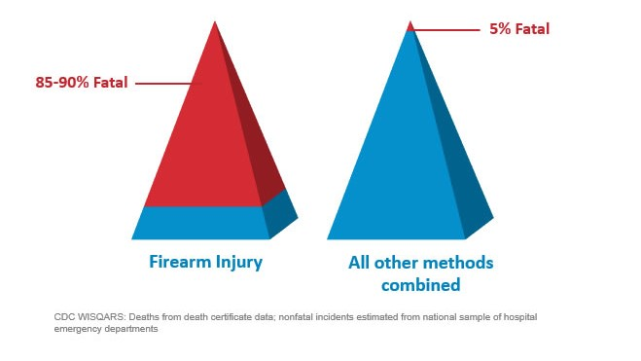
Time From Decision to Action < 1 Hour
Source: Simon, T.R., Swann, A.C., Powell, K.E., Potter, L.B., Kresnow, M., and O’Carroll, P.W. Characteristics of Impulsive Suicide Attempts and Attempters. SLTB. 2001; 32(supp):49-5

Slide 22
The Do’s and Don’ts
Do’s
Don’ts
DO ask the question if you’ve identified warning signs or symptoms.
DON’T ask the question as though you are looking for a “no” answer.
“You aren’t thinking of killing yourself, are you?”
DO ask the question in a natural way that flows with the conversation.
DON’T wait to ask the question when someone is halfway out the door.

Slide 23

Anchors of Hope
Anchor 1: 399 fewer Veterans died from suicide in 2019 than in 2018.
Anchor 2: From 2005 to 2018, identified Veteran suicides increased on average by 48 deaths per year. A reversal totaling 399 lives within one year is unprecedented, dating back to 2001.
Anchor 3: Decrease in the adjusted suicide rate for Veterans from 2018 to 2019 (7%) was larger than any observed for Veterans 2001 through 2018. Veteran rate of decrease (7.2%) exceeded by four times the non-Veteran population decrease (1.8%)
Anchor 4: There was a nearly 13% one-year (unadjusted) rate decrease for female Veterans, which represents the largest rate decrease for Women Veterans in 17 years.
Anchor 5: COVID-19-related data continues to emerge and clarify, but data thus far does not indicate an increase in Veteran suicide-related behaviors.
Notes:
Anchor 1: 399 fewer Veterans died from suicide in 2019 than in 2018, reflecting the lowest raw count of Veteran suicides since 2007.
Anchor 2:From 2005 to 2018, identified Veteran suicides increased on average by 48 deaths per year. A reversal totaling 399 lives within one year is unprecedented, dating back to 2001.
Anchor 3: The single year decrease in the adjusted suicide rate for Veterans from 2018 to 2019 (7%) was larger than any observed for Veterans from 2001 through 2018. Further, the Veteran rate of decrease (7.2%) exceeded by four times the non-Veteran population decrease (1.8%) from 2018 to 2019.
Anchor 4: There was a nearly 13% one-year rate decrease (unadjusted rate) for female Veterans from 2001 to 2019.
Anchor 5: COVID-19-related data continues to emerge and clarify, but data thus far does not indicate an increase in Veteran suicide-related behaviors. Additionally, the level of differential mortality by mental health status has not increased since the pandemic began.
While we hold fast to the anchors of hope in this report, there is more work to do to address Veteran suicide in partnership together.
Page 17 of the 2021 Annual Report “399 fewer, we still have 6,261 to go. We hold this belief to be true: Suicide is preventable on the individual and on the community level... We have the heart and the will, but we know that suicide prevention will require all of us collectively and uniquely engaged within a unifying and overriding goal of saving lives from suicide. We, therefore, continue to seek everyone’s support, partnership, and engagement.”

Slide 24
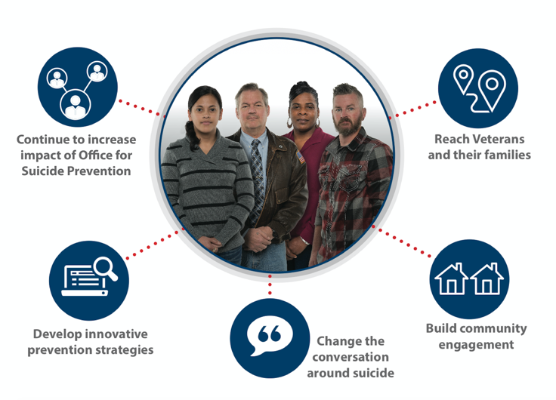
Suicide Prevention is Everyone’s Business
Notes:
Veterans do not live, work, and serve in isolation from the community, the nation, or the world. The issue of suicide in the U.S. also affects the Veteran population. That's why we are working with an extensive network of community partners across the country to prevent suicide among all Veterans including those who may never come to VA for care.
No one system can prevent suicide. It is a shared responsibility. As such, VA has embraced a comprehensive public health approach to reduce Veteran suicide rates, one that looks beyond the individual to involve peers, family members, and the community. Yet we know we cannot do it alone, as roughly half of all Veterans in the U.S. do not receive services or benefits from VA. This means we must collaborate with partners and communities nationwide to use the best available information and practices to support all Veterans, whether or not they’re engaging with VA.
Recommend an upstream approach to suicide prevention; that is, rather than jumping in the river to rescue someone, try to reach them before they get in the water. An upstream approach requires less resources and less energy and can reach more people. The hardest time to intercept someone is when they are already in a state of crisis so in the slides to follow, we will address this public health strategy and the programming to make it possible.

Slide 25


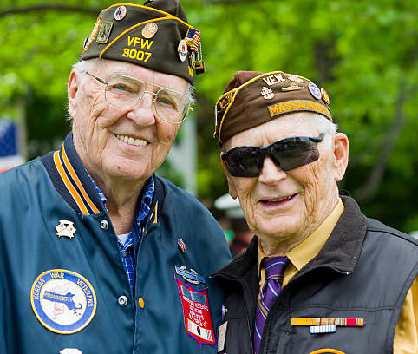
VETERAN?
IT IS IN THE ASK
Have your or a member of your family every served in the US Military?
Notes:
Veterans have a unique perspective and a unique demeanor
They rarely take
Usually think someone needs the service or benefit more
Often minimize their contribution

Slide 26
Veteran Eligibility & Enrollment
Kelli Maxon, Health Benefits Advisor
Battle Creek VA Medical Center

Slide 27
How Can A Veteran Apply For Benefits?
Mail Application
Apply in Person @ your local VA Clinic
Faxing in your application
Applying online at VA.gov
Apply by Phone @ (877)222-8387

Slide 28
DOCUMENTS NEEDED TO APPLY FOR BENEFITS
FULLY completed application – VA Form 1010EZ
A legible copy of your DD214, NAVPERS 553, or WD AGO53-55
Household Income for Previous Tax Year
If you are National Guard or Reserves only – MUST have proof of Title 10 Activation

Slide 29
VHA ELIGIBILITY REQUIREMENTS
You served in the active military, naval, or air service, and
You didn’t receive a dishonorable discharge or Other Than Honorable, and
You must meet at least one of these service requirements:
  You served at least 24 months consecutive service after September 7th, 1980, or
  You were discharged for a service-connected disability, or
  You were discharged for a hardship or “early out,” or
  You served 1 active-duty day before September 7, 1980, or
  Have a service-connected disability
NOTE: TIME SPENT ON ACTIVE-DUTY STATUS FOR TRAINING PURPOSES ONLY DOESN’T COUNT TOWARD THE SERVICE REQUIREMENTS.

Slide 30
DID YOU KNOW?
Even if you are ineligible for VHA services the Enrollment & Eligibility Office can assist you with outside resources for all your healthcare needs.

Slide 31
HAVE QUESTIONS?
BATTLE CREEK VA ENROLLMENT OFFICE
BY PHONE - (269) 966-5600 EXT. 33887
IN PERSON – 5500 ARMSTRONG RD, BATTLE CREEK MI (BUILDING 2, ROOM 0074)
WYOMING HEALTH CARE CENTER ENROLLMENT OFFICE
BY PHONE - (616) 249-5300 EXT 30366
IN PERSON – 5838 METRO WAY, WYOMING MI (1ST FLOOR, ROOM 1B107)

Slide 32
Suicide Prevention 2.0
Public Health Strategy

Slide 33
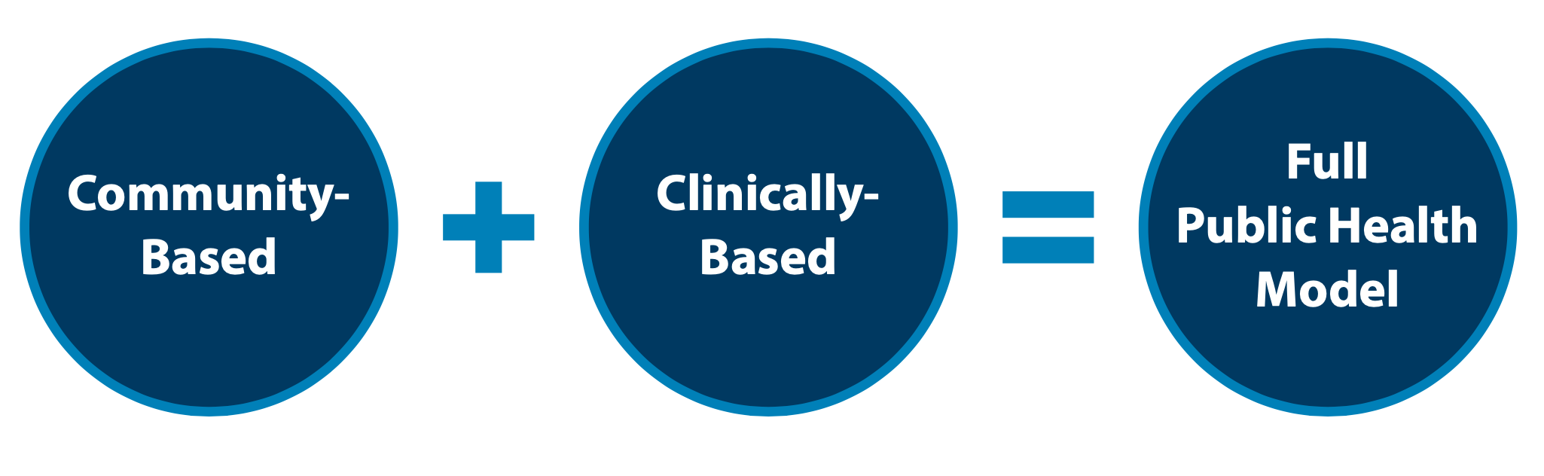
Public Health Strategy
VA's public health strategy combines partnerships with communities to implement tailored, local prevention plans while also focusing on evidence based clinical strategies for intervention. Our approach focuses on both what we can do now, in the short term, and over the long term, to implement VA’s National Strategy for Preventing Veteran Suicide.
Notes:
Suicide is a public health challenge that causes far-reaching pain among individuals, families, and communities across the country. Suicide is also preventable. Veteran suicide is an urgent issue that the U.S. Department of Veterans Affairs (VA), along with its stakeholders, partners, and communities nationwide, must address. VA supports the national goal of reducing the annual suicide rate in the U.S. by 20 percent by the year 2025 and is implementing a public health approach to achieve this mission.
In 2020, VA translated the vision offered by the 10-year National Strategy and its four major domains into operational plans of actions through the Suicide Prevention 2.0 initiative (SP 2.0). SP 2.0 focuses on nationally implementing and operationalizing across a 6-year period new and bundled community-based and clinically based services and programs reflective of the National Strategy to expand VA’s approach to prevent Veteran suicide nationwide. SP 2.0 aligns suicide prevention, intervention, and postvention goals across clinical and community settings to reach and serve Veterans both within and outside VHA clinical care at national, state, and local levels.

Slide 34
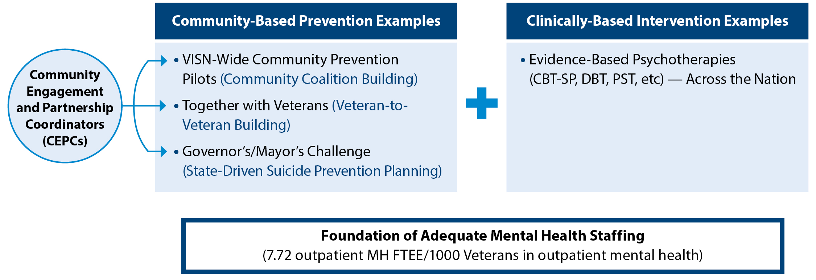
Suicide Prevention 2.0 Vision for the Distance:
Combining Community & Clinical Interventions
Community-Based Prevention Strategies
Clinically-Based Interventions
Veterans Integrated Service Networks (VISN)-Wide Community Prevention Pilots (community coalition building)
Together With Veterans (Veteran-to-Veteran building)
Governor’s/Mayor’s Challenge (state-driven suicide prevention planning)
Evidence-based psychotherapies & interventions implemented through clinical video telehealth
  Cognitive Behavior Therapy for Suicide Prevention (CBT-SP)
  Problem-Solving Therapy for Suicide Prevention (PST-SP)
  Dialectical Behavior Therapy
  Safety Planning Intervention
Foundation of Adequate Mental Health Staffing
(7.72 outpatient mental health full-time equivalent employees/1,000 Veterans in outpatient mental health)
Notes:
VA has undertaken substantial Veteran suicide prevention efforts. VA’s public health approach for Veteran suicide prevention incorporates long-term community- and clinically-based initiatives, as part of the Suicide Prevention 2.0 initiative.
Community-based approaches include:
-- Veterans Integrated Service Network-Based Community Coalition and Collaboration Building (e.g., VISN-wide community suicide prevention pilot programs)
-- Veteran-to-Veteran Coalition Building (e.g., Together With Veterans)
-- State-Based Coalition and Collaboration Building (e.g., Governor’s Challenge)
Clinically-based approaches include:
-- Evidenced-based psychotherapy interventions for suicide prevention via telehealth across all VISN Clinical Resource Hubs (e.g., Cognitive Behavioral Therapy for Suicide Prevention)
-- Ensuring VHA mental health staffing availability (e.g., foundation levels of mental health and suicide prevention staffing to ensure success)
-- Using the VA-DoD Clinical Practice Guidelines to build plans upon the evidence. The guidelines provide the latest information about evidence based practices for suicide prevention and also contain recommendations for screening and evaluation.
Foundation for adequate MH Staffing:
(minimum benchmark for suicide prevention staffing is 1.0 SPC (FTEE)/ 10,000 facility uniques) ---from previous slide

Slide 35
Suicide Prevention 2.0
Community-Based Interventions for Suicide Prevention (CBI-SP)

Slide 36

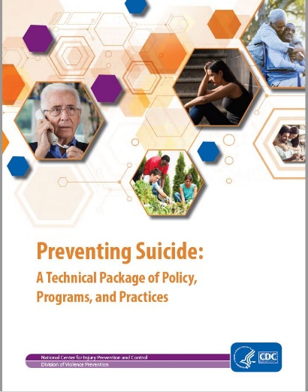
CDC’s Preventing Suicide Technical Package
Strengthen Economic Supports
Strengthen Access and Delivery of Suicide Care
Create Protective Environments
Promote Connectedness
Teach Coping and Problem-Solving Skills
Identify and Support People at Risk
Lessen Harms and Prevent Future Risk
36
Notes:
This technical package represents a select group of strategies based on the best available evidence to help communities and states sharpen their focus on prevention activities with the greatest potential t o prevent suicide.
The strategies represented in this package include those with a focus on preventing the risk of suicide in the first place as well as approaches to lessen the immediate and long-term harms of suicidal behavior for individuals, families, communities, and society. The strategies in the technical package support the goals and objectives of the National Strategy for Suicide Prevention and the National Action Alliance for Suicide Prevention’s priority to strengthen community-based prevention.
Link to the CDCs Preventing Suicide Technical Assistance Manual - https://www.cdc.gov/violenceprevention/pdf/suicideTechnicalPackage.pdf

Slide 37



Focused Priority Areas Across CBI-SP Unifying Model
Identify Service Members, Veterans, and their Families and Screen for Suicide Risk
Promote Connectedness and Improve Care Transitions
Increase Lethal Means Safety and Safety Planning
Notes:
The National Strategy for Preventing Veteran Suicide 2018-2028 provides a framework for identifying priorities, organizing efforts, and contributing to the national focus on Veteran suicide prevention. The 14 goals and 43 objectives in the National Strategy work together in a synergistic way to promote wellness, increase protection, reduce risk, and promote effective treatment and recovery. Evidence suggests that the three priority areas highlighted here can help in reducing suicide rates.
SP 2.0 Community Based Intervention (CBI-SP) promotes these priority areas and emphasizes their critical sub-elements (six goals in total) in alignment with the National Strategy and therefore State, regional, and local teams are encouraged to use these priorities as key elements in their suicide prevention strategic plans.
1) Identify Service Members, Veterans, and their Families and Screen for Suicide Risk
Identifying Veterans — "Ask the Question" — enables culturally competent care and access to resources; allows community members, families, and community service providers to connect individuals to appropriate care
Suicide risk screening in healthcare settings allows providers to recognize and prevent self-harm
2) Promote Connectedness and Improve Care Transitions
Connectedness to others (including family members, co-workers, community organizations, and social institutions) is an important protective factor
Providing caring contacts upon discharge from one setting to another can reduce suicide attempts and increase compliance with treatment recommendations
3) Increase Lethal Means Safety and Safety Planning
Limiting access to lethal means during periods of crisis can make it more likely that the person will delay or survive a suicide
Completing a personal safety plan is a clinical intervention that can help individuals manage and decrease suicidal feelings and help them stay safe when these feelings reoccur

Slide 38
Priority Areas & CDC Strategies are Complementary
Identify Service Members, Veterans, and their Families and Screen for Suicide Risk
Strengthen Access and Delivery of Suicide Care
Identify and Support People at Risk
Promote Connectedness and Improve Care Transitions
Strengthen Access and Delivery of Suicide Care
Promote Connectedness
Teach Coping and Problem-Solving Skills
Lessen Harms and Prevent Future Risk
Increase Lethal Means Safety and Safety Planning
Strengthen Access and Delivery of Suicide Care
Create Protective Environments
Notes:
Learning from the early adoptions of strategies by early Governor's Challenge teams, several key priorities of the seven original strategies from the CDC Technical Package were identified as foundational to the work at the state level.
Connecting CDC 7 Strategies to VA/SAMHSA's 3 Priority Areas:
Priority Area 1 (Identification and Screening) is directly related to Strategies 2 (Strengthen Access and Delivery of Suicide Care) and 6 (Identify and Support People at Risk). Priority Area 2 (Promoting Connectedness and Improving Care Transitions), one of the most popular of activity areas by Governor's Challenge teams, directly connects back to CDC Strategies 2 (Strengthen Access and Delivery of Suicide Care), 4 (Promote Connectedness), 5 (Teach Coping and Problem Solving Skills), and 7 (Lessen Harms and Prevent Future Risk). Priority Area 3 (Increasing Lethal Means Safety and Safety Planning), relates to CDC Strategies 2 (Strengthen Access and Delivery of Suicide Care) and 3 (Create Protective Environments).
Given the dynamics and infrastructure of coalitions being varied across jurisdictions, the core Priority Areas offer communities the ability to connect coalition efforts to activities that meet the needs of the local community and can be addressed given the resources available.

Slide 39
Community-Based Interventions
Community-Based Interventions for Suicide Prevention (CBI-SP) serves as unifying model, from national to community levels, for all community-based efforts to end Veteran suicide.
The Governor’s Challenge is a collaboration with VA and SAMHSA where state policy makers partner with local leaders to implement a comprehensive suicide prevention plan.
Together with Veterans is focused on Veteran-to-Veteran coalition building and Veteran leadership development for suicide prevention.
Community Engagement and Partnerships for Suicide Prevention (VISN Expansion) is focused on facilitating community coalition building for suicide prevention
Outreach and Education provides SAVE, VHA facility partnerships, events, etc. through local Suicide Prevention Coordinators (SPCs) and does not change their critical role.
National Level
National VA Suicide Prevention Program
State Level
Governor’s Challenge
Community Engagement and Partnerships for Suicide
Prevention
Community
Level
Together With Veterans
Outreach and Education
Notes:
The Community-Based Interventions for Suicide Prevention serves as a unifying model aims to reach Veterans through multiple touchpoints – from national to community levels, for all community-based efforts to end Veteran suicide.

Slide 40
Community-Based Interventions for Suicide Prevention (CBI-SP) serves as a unifying model, from national to community levels for all community-based efforts to end Veteran suicide.
Governor’s Challenge is a collaboration with the VA and SAMHSA where state policy makers partner with local leaders to implement a comprehensive prevention plan. This partnership involves forming an interagency team to develop a strategic action plan that addresses Veteran suicide at the state level that includes community, municipal, military and other stakeholders.
Together with Veterans (TWV) is a collaborative, evidence-informed and community centered program that enlists rural Veterans to act as change agents by providing training and support to their peers and local partners. This program is focused on Veteran-to-Veteran coalition building and Veteran leadership development for suicide prevention.
Community Engagement and Partnership for Suicide Prevention is focused on community coalition-building and enhanced capacity for outreach and education.
*While the local Suicide Prevention Coordinators provide outreach and education, the Community Engagement and Partnership Coordinators focus on community engagement and coalition building.
Notes:
The Community-Based Interventions model embraces cross-agency collaborations and community partnerships to meet Veterans where they live, work, and thrive. The VA’s Community-Based Interventions (Governor’s Challenge, CEP-SP, and Together With Veterans) are all grounded in effective practice of community-based prevention and community implementation science paired with a focus on disseminating suicide prevention strategies within communities across the country
The Governor’s Challenge is a collaboration with VA and SAMHSA where state policy makers partner with local leaders to implement a comprehensive suicide prevention plan.
Together with Veterans is focused on Veteran-to-Veteran coalition building and Veteran leadership development for suicide prevention.
Community Education and Partnership for Suicide Prevention across the VISN is focused on community coalition-building and enhanced capacity for outreach and education.

Slide 41
Together with Veterans
Together with Veterans (TWV) is funded by the Office of Rural Health and enlists rural Veterans and their local partners to join forces to reduce Veteran suicide in their community. ​
TWV is Veteran-driven, collaborative, evidence-informed, and community-centered. ​
TWV provides training and support for rural Veterans to become leaders of change in their communities and supports Veterans, as well as their community partners in implementing best practices for suicide prevention. ​
TWV is currently being implemented in over a dozen communities.
  2 graduated sites are operating independently, with additional sites graduating this year.
14 more sites are planned to be launched over the next year.

Slide 42
Community Engagement and
Partnerships Program

Slide 43
Suicide Prevention Team Integration and Coordination
Suicide Prevention Coordinators (SPC)
Enhanced Care Management of Veterans at High Risk of Suicide
Community Engagement and Partnership Coordinators (CEPC)
Establish New Community Coalitions / Support Existing Coalitions
Facility Suicide Prevention Program Coordination and Implementation of Clinical Evidence-Based Practices for SP
Veterans Crisis Line Facility Consultant
Community Outreach and Education
Facilitate Community, Regional, and State-Level Efforts to Implement Evidence-Informed Community-Based SP Practices
Facility Suicide Prevention Training
Bolster the public health approach through:
Community engagement, coalition building, needs assessment and environmental scans, action planning, implementation of systems and community-level change initiatives, program evaluation, and sustainment of community efforts/coalitions
Both SPCs and CEPCs work together to fully implement the public health approach combining community and clinical interventions to reach all Veterans across the universal, selective and indicated populations.
Notes:
Community Based Interventions for Suicide Prevention (CBI-SP) serve to enhance and expand current VA suicide prevention efforts that are facilitated by over 450 suicide prevention team members nationwide.
Suicide Prevention Coordinators (SPC) and their teams are critical supports to our Veterans and traditionally have focused on implementing local strategies for suicide prevention.
New facility-based Community Engagement and Partnership Coordinators (CEPC) join local VA suicide prevention teams as staff who collaborate at the community, regional, and state levels, to implement evidence-informed community-based suicide prevention interventions
CEPCs will establish new community coalitions for veteran suicide prevention, participate in and support the dissemination of the Together With Veterans Rural Suicide Prevention Program, support other existing coalitions, such as Governors/Mayor’s Challenges, who have missions aligned with VA’s CBI-SP program, and provide much needed expansion to local SPCs and the suicide prevention teams’ capacity to conduct outreach and education.
Some key points:
CBI-SP serves to enhance and expand current VA suicide prevention efforts that are facilitated by over 450 suicide prevention team members nationwide.
SPCs and their teams are critical supports to our Veterans and traditionally have focused on implementing local strategies for suicide prevention.
New facility-based CEPCs, are hired to integrate and join local VA suicide prevention teams as staff who are 100% administrative and who will collaborate at the community, regional, and state levels, to implement evidence-informed community-based suicide prevention interventions
CEPCs will collaborate closely with SPCs and other members of VA suicide prevention teams to enhance the new partnerships and bolster the public health approach through community engagement, community building and sustainment.
CEPCs brings a new emphasis on public health planning, partnered and collaborative action, and effective community practice for suicide prevention.

Slide 44
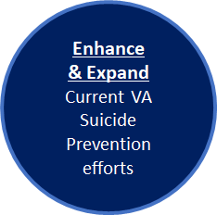
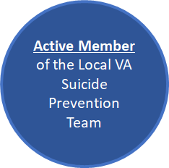
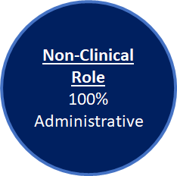
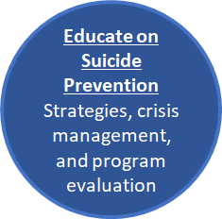
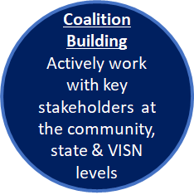
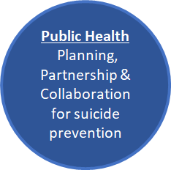
Community Engagement and Partnership Coordinator (CEPC) Overview
Notes:
New Slide and notes added
CEPCs serve as subject matter experts in public health approaches, coalition leadership and management, and other community-based models for suicide prevention regarding Veterans. Here, they collaboratively work with key stakeholders to develop, facilitate, and strengthen CBI-SP at community, state, and VISN levels. This program emphasizes public health planning, partnered and collaborative action and effective community practice for suicide prevention.
The CEPC role is intended to enhance and expand current VA suicide prevention efforts that are facilitated by over 450 suicide prevention team members nationwide. CEPCs are 100% administrative and a non-clinical position, to fully collaborate & implement evidence-informed community-based suicide prevention strategies. Here, CEPCs are an active member of their local VA Suicide Prevention Team(s) and collaborate closely with the team and key community stake holders to bring a new emphasis on public health planning, partnered and collaborative action, and effective community practice for suicide prevention.

Slide 45
Community Engagement and Partnership Coordinator
Key roles of the CEPC:
  Develop, facilitate, and strengthen CBI-SP at community, state, and VISN levels
  Collaborate with VA programs and community stakeholders
  Provide leadership for coalition management
  Disseminate program evaluation and surveillance data
The CEPC serves a subject matter expert of public health approaches, coalition leadership and management, and other community-based models for suicide prevention regarding Veterans.
Notes:
To carry out this important initiative, CEPCs will tap into existing partnerships, as well act as an instrumental part in planning new suicide prevention coalitions to more broadly disseminate information about suicide risk, awareness of how the public may participate in keeping Veterans safe and access to resources.
Here, CEPCs apply a public health approach, coalition leadership and management, and other community-based models for suicide prevention. They collaboratively work with key stakeholders to develop, facilitate and strengthen CBI-SP. This program emphasizes public health planning, partnered and collaborative action and effective community practice for suicide prevention.
Because suicide is everybody's business.
Listed Functions:
Develop, facilitate, and strengthen CBI-SP at community, state, and VISN levels
Connect VA programs and stakeholders (Veterans, VSOs, Congressional Staff, etc.)
Serve as a public health and suicide prevention SME
Provide leadership for coalition management
Establish and maintain strong relationships between VA Suicide Prevention team and community-based Veteran organizations and leadership
Comprehend and maintain knowledge of current VA guidelines, policies, Federal regulations, and laws governing benefits for Veterans
Disseminate program evaluation and surveillance data .
Develop material and training programs
Develop and deliver education and outreach services that encompass underserved Veteran populations and expands SP coalition building in communities
Develop and maintain content expertise in Suicide Prevention
Promote and utilize evidence-based guidelines at all stages of program development and implementation

Slide 46
Partnerships Lead to Better Outcomes
Tactics
Partnerships promoted by healthcare organizations with communities have been shown to improve patient outcomes (Clyne et al., 2012).
Implementing research-informed communication efforts designed to prevent Veteran suicide by changing knowledge, attitudes, and behaviors is critical. The U.S. Air Force implemented a public health universal approach which significantly lowered suicide rates through comprehensive organizational changes including communication efforts (Knox et al., 2010).
  This model also included gatekeeper training which has been shown to reduce suicidal ideation and deaths by suicide while positively affecting the knowledge, skills, and attitudes of trainees through improving communication (Isaac et al., 2009).
Building Partnerships
•Initial Contact
•Discovery Call
•Vetting
•Partner Plan Development
Sustaining Partnerships
•Execute Activities
•Regular Communications
•Assess Efforts/Revise
Director’s Engagements
•Event Analysis
•10N Staff Coordination
•Product Review
SP Partnerships Briefings
•VA Internal/External Briefings
VA – Internal Coordination
•VACO-level Offices
•VBA, CMV, CWV, etc.
Communications Products
•OPIA Support
•Press Releases, Blogs
•Partner Products
Notes:
The National Strategy emphasizes this important role that community-based programs and services can play in suicide prevention, but many communities may not know where to start or what they can do. It notes that a wide range of community partners (e.g., schools, workplaces, faith-based organizations, businesses, law enforcement, health care systems, and others), working together, can deliver prevention programs and services to high-risk groups at the local level, and that “greater coordination among community and clinical preventive service providers can have synergistic effects in preventing suicide and related behaviors.”1
As communities vary in type, size, and composition, CEPCs in partnership with Program Managers and the Technical Assistance Resource Center, can provide more specific guidance combined with implementation options and suggestions as partnerships are developed throughout their respective VISNs. Examples of Partnership opportunities and tactics are on the next slide.
NEW SLIDE Sources:
Clyne, W., White, S., & McLachlan, S. (2012). Developing consensus-based policy solutions for medicines adherence for Europe: A Delphi study. BMC Health Services Research, 12(1), 425.
Knox, K. L., Pflanz, S., Talcott, G. W., Campise, R. L., Lavigne, J. E., Bajorska, A., Tu, X., & Caine, E. D. (2010). The US Air Force suicide prevention program: Implications for public health policy. American Journal of Public Health, 100(12), 2457-2463.
Isaac, M., Elias, B., Katz, L. Y., Belik, S. L., Deane, F.P., Enns, M.W., & Sareen, J. (2009). Gatekeeper training as a preventative intervention for suicide: A systematic review. The Canadian Journal of Psychiatry, 54(4), 260–268.

Slide 47
Examples of Partnerships
Tactics
Governor’s Challenge: Partnership with SAMHSA to implement VA’s National Strategy for Suicide Prevention using a public health approach
  Currently, 35 state teams have accepted the challenge
  Aim to engage with all states and territories in FY22
PsychArmor S.A.V.E Training: 25-minute suicide prevention training video available online 24/7
Suicide Prevention Month: Integrating SP Month planning and SP messaging with VHA Communications, and bi-weekly with PREVENTS/Department of Defense
National Shooting Sports Foundation/American Foundation Suicide Prevention: Safe Firearm Storage Toolkit
Building Partnerships
•Initial Contact
•Discovery Call
•Vetting
•Partner Plan Development
Sustaining Partnerships
•Execute Activities
•Regular Communications
•Assess Efforts/Revise
Director’s Engagements
•Event Analysis
•10N Staff Coordination
•Product Review
SP Partnerships Briefings
•VA Internal/External Briefings
VA – Internal Coordination
•VACO-level Offices
•VBA, CMV, CWV, etc.
Communications Products
•OPIA Support
•Press Releases, Blogs
•Partner Products
Notes:
Updated Notes.
These are opportunities and tactics to be used as part of the development of partnerships. In review, CEPCs establish new Partnerships and community coalitions for veteran suicide prevention, participate in and support the dissemination of the Together With Veterans Rural Suicide Prevention Program, support other existing coalitions, such as Governor’s and Mayor’s Challenges, who have missions aligned with VA’s CBI-SP program, and provide much needed expansion to local SPCs and the suicide prevention teams’ capacity to conduct outreach and education.
In addition to some of these existing entities, the CEPCs will also focus on building new coalitions.

Slide 48
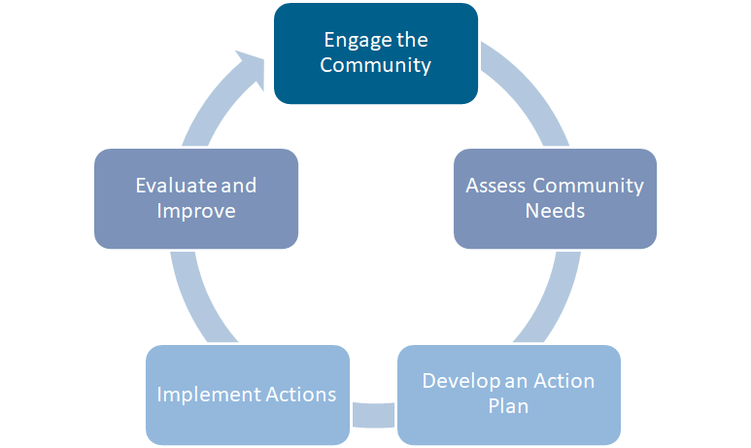
Effective Community-Based Suicide Prevention
For successful coalition building, it is important that all members actively participate in:
Developing Shared Vision
Needs Assessment
Organizational Capacity
Planning
Implementation
Evaluation
Sustainability
Notes:
Updated and changed (removed the competencies & gave ownership to all parties to set up for success).
Effective community based and public health suicide prevention practices include community engagement, coalition and team building, needs assessment and action planning, implementation of best practices in community systems, program evaluation, and sustainment of community efforts (Kania et al., 2011; Wantersman et al., 2000; Chinman et al., 2004).
The goal of CBI-SP is to establish a national comprehensive program for community-based efforts for suicide prevention (Frieden, 2014; Lai et al., 2019). This will be accomplished through a three-year phased implementation of effective CBIs across national, state, tribal, and community levels with the objective of reducing Veteran suicide nationwide. The VA’s chosen CBIs (Governor’s Challenge, CEP-SP, and Together With Veterans) are all grounded in effective practice of community-based prevention and community implementation science paired with a focus on disseminating suicide prevention strategies within communities across the country (Frieden, 2014; Lai et al., 2019).
Forming and supporting coalitions entails specific strategies to engage community stakeholders, develop a shared vision, assess the community, develop an action plan for the coalition, and implement, evaluate, improve and sustain the efforts of the coalition. The CEPCs and CEP-PMs look forward to collaboratively working on this together with you, our community partners, and we seek to eliminate Veteran suicides.

Slide 49
Community Engagement and Partnerships Program: Anticipated Outcomes
Short-Term Objectives
Intermediate Objectives
Population Impact
Enhanced suicide prevention networks​
Increased engagement with Veterans
Increased reach and adoption of CBI-SP
Reduced gaps in community-based suicide prevention systems ​
Improved community climate outcomes
Increased formal help-seeking / use of care​
Increased referrals from multiple sources
Improved treatment engagement and retention among Veterans seeking care ​
Enhanced community collaboration regarding Veteran services and suicide prevention​
Increased access to safe firearms storage options​
Increased willingness to discuss and use safe firearms storage
Reduced Veteran suicide deaths and attempts ​
Reduced all-cause mortality​
Reduced suicide ideation
Notes:
Facilitator’s Notes: The anticipated outcomes for the Community Engagement and Partnerships Program are:
Short-Term Objectives:
Enhanced suicide prevention network​
Increased engagement with Veterans
Increased reach and adoption of CBI-SP​ through:
Increased identification of Veterans
Increased screening for suicide risk​
Increase actions for care coordination​
Increased community actions that promote connectedness​
Increased training and practices for Lethal Mean Safety​
Increased safety planning ​
Reduced gaps in community-based suicide prevention systems ​
Improved community climate outcomes
Intermediate Objectives:
Increased formal help-seeking / use of care​
Increased referrals from multiple sources (formal and informal; during crisis and pre-suicide crisis) ​
Improved treatment engagement and retention among Veterans seeking care ​
Enhanced community collaboration regarding Veteran services and suicide prevention​
Increased access to safe firearms storage options​
Increased willingness to discuss and use safe firearms storage (among Veterans and providers)
Population Impact:
Reduced Veteran Suicide deaths and attempts ​
Reduced all-cause mortality​
Reduced suicide ideation

Slide 50
Discussion & Questions
Notes:
Updated
Prompting questions:
-How might we be able to partner together further for continuity related to implementation academies for the last 21 states? (Previous Question)
-When you think about Veterans in your life, where do you see opportunities we can help with?
-What resources and/or partnerships are valuable in your area?

Slide 51
Thank You
Notes:
New Slide
Thank you for your investment, support and commitment to eliminating Veteran Suicide. We value the opportunity to work together with you.

Slide 52
VHA Suicide Prevention Resources

Slide 53
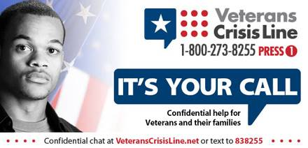
Free, Confidential Support 24/7/365
Veterans
Service members
Family members
Friends
Coworkers
Notes:
Veterans Crisis Line: The Veterans Crisis Line connects Veterans in crisis and their families and friends with qualified, caring VA responders through a confidential toll-free hotline, online chat, or text. Veterans and their loved ones can call 1-800-273-8255 and Press 1, chat online, or send a text message to 838255 to receive confidential crisis intervention and support 24 hours a day, 7 days a week, 365 days a year. More information is available at https://www.veteranscrisisline.net/.

Slide 54

Make the Connection
Online resource featuring hundreds of Veterans telling their stories about overcoming mental health challenges
MakeTheConnection.net/conditions/suicide
Notes:
Make the Connection: This online resource connects Veterans, their family members and friends, and other supporters with information and solutions to issues affecting their lives. More information is available at https://maketheconnection.net/.

Slide 55

VA SAVE Training
Suicide prevention training video available to everyone, 24/7
Less than 25 minutes long
Offered in collaboration with the PsychArmor Institute
Available online for free: psycharmor.org/courses/s-a-v-e/
Notes:
Double Check to see if there aren't updated #'s
Updates from February 2019:
Number of VA employees who have taken the training (through 2/11/19) from our VA TMS system:
SAVE course: 111,044
SAVE Refresher: 181,620
Our current metrics show the SAVE course has been viewed 18,076 times since it was launched in mid-2018.
S.A.V.E. training video: An online suicide prevention training video launched in collaboration with PsychArmor Institute. The training video is designed to help equip anyone who interacts with Veterans to demonstrate care, support, and compassion when talking with a Veteran who could be at risk for suicide. The 25-minute training video is available for free at: https://psycharmor.org/courses/s-a-v-e/.

Slide 56

Coaching into Care
National VA telephone service which aims to educate, support, and empower family members and friends who are seeking care or services for a Veteran
CALL 888-823-7458
Notes:
Coaching into Care (1-888-823-7458): A national telephone service of the VA, Coaching into Care aims to educate, support, and empower family members and friends who are seeking care or services for a Veteran. More information is available at https://www.mirecc.va.gov/coaching/.

Slide 57

Be There Prevention Initiative
Notes:
#BeThere Prevention Initiative: The #BeThere prevention initiative teaches members of the community how simple acts can help save a Veteran in crisis. More information is available at https://www.veteranscrisisline.net/BeThere.aspx.

Slide 58
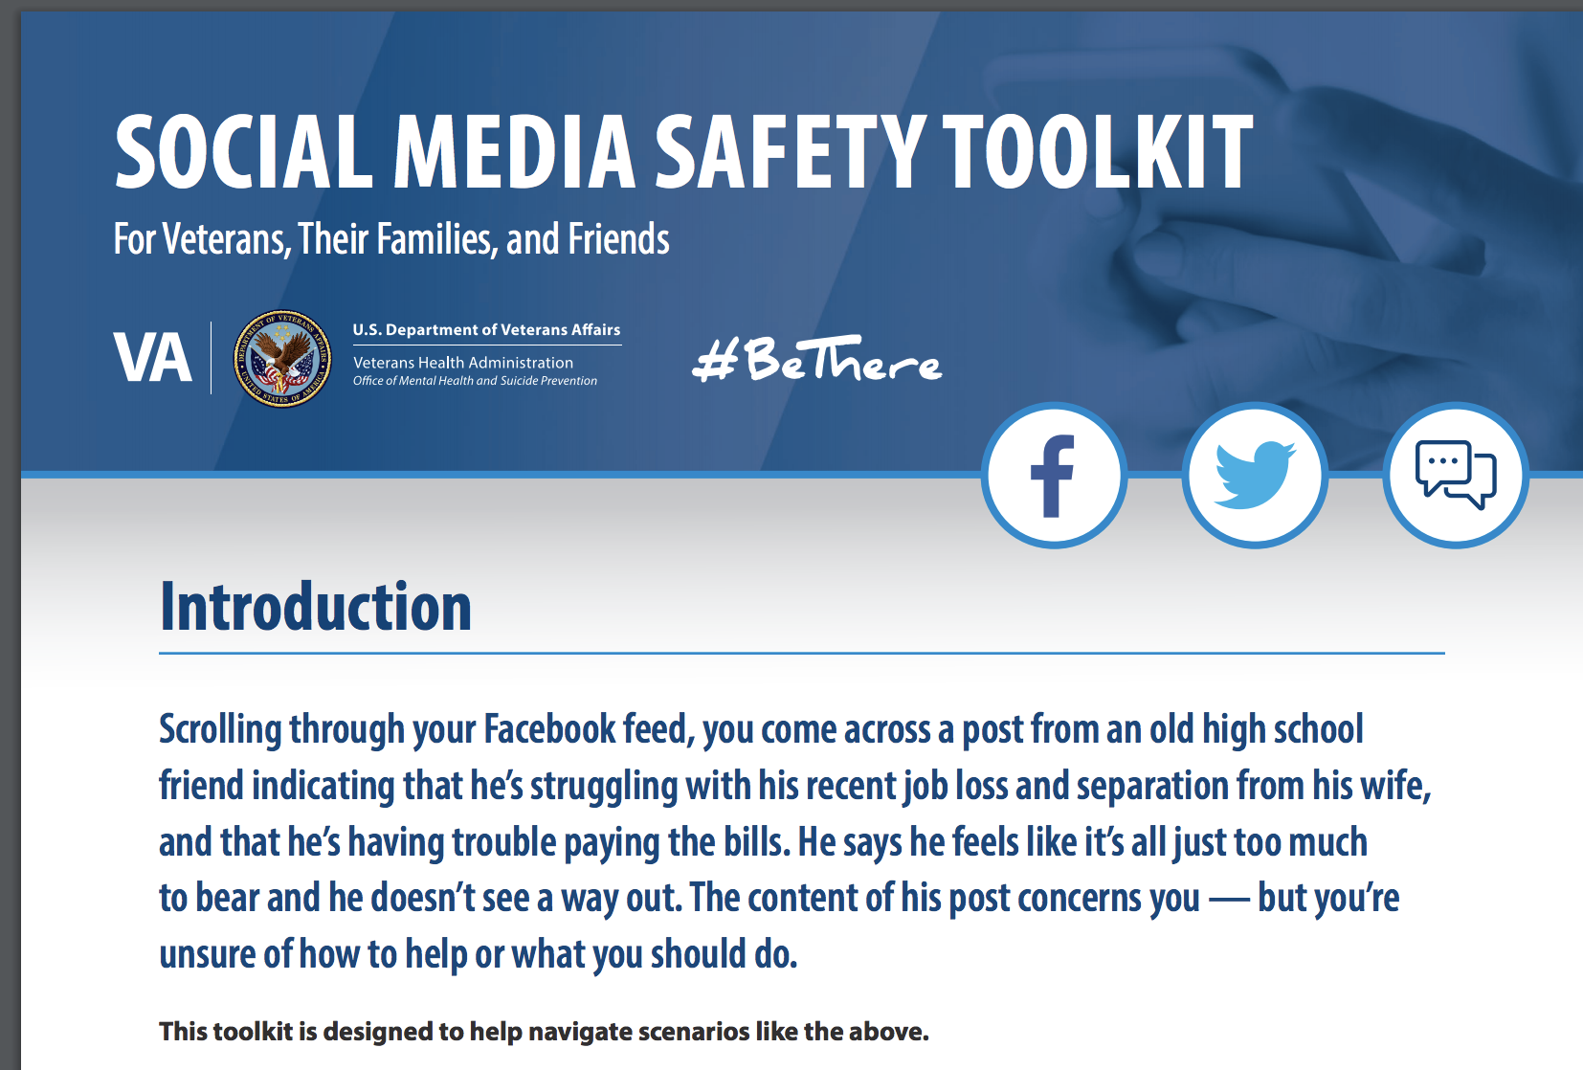

Social Media Safety Toolkit
As discussed in the National Strategy for Preventing Veteran Suicide, social media is an important intervention channel and a key piece of VA’s comprehensive, community-based suicide prevention strategy.
The Social Media Safety Toolkit for Veterans, their families, and friends equips everyone with the knowledge needed to respond to social media posts that indicate a Veteran may be having thoughts of suicide.
The toolkit includes best practices, resources, and sample responses.
Download at https://www.mentalhealth.va.gov/suicide_prevention/docs/OMH-074-Suicide-Prevention-Social-Media-Toolkit-1-8_508.pdf
Notes:
The Social Media Safety Toolkit for Veterans, Their Families, and Friends equips everyone with the knowledge needed to respond to social media posts that indicate a Veteran may be having thoughts of suicide. The toolkit includes best practices, resources, and sample responses.
As discussed in the National Strategy for Preventing Veteran Suicide, social media is an important intervention channel and a key piece of VA’s comprehensive, community-based suicide prevention strategy.
Many service members and Veterans are active on social media platforms, and some have posted to express emotional distress or thoughts of suicide. Social media has become a critical channel for VA and partners like you to reach Veterans in crisis with safe messaging and resources.
VA is sharing the Social Media Safety Toolkit among VA employees, with partner organizations, and throughout communities nationwide to help ensure that people who live and work with Veterans every day are equipped to reach Veterans with safe messaging and lifesaving resources.
Download the Social Media Safety Toolkit at https://www.mentalhealth.va.gov/suicide_prevention/docs/OMH-074-Suicide-Prevention-Social-Media-Toolkit-1-8_508.pdf.

Slide 59
Lethal Means Safety Toolkit
Developed in partnership with the American Foundation for Suicide Prevention (AFSP) and the National Shooting Sports Foundation (NSSF), the trade association for the firearms industry.
Toolkit guides communities through the process of building coalitions to raise awareness about safe storage and its connection to suicide prevention.
Safe storage can put time and space between an individual and a firearm during suicidal crisis and shows promise for reducing rates of suicide.
VA respects the important role firearms play in many Veterans’ lives and is dedicated to providing safe storage options that are consistent with each Veteran’s values and priorities. Help Veterans and their loved ones make their homes safer and share these resources with your network.
Access the toolkit online:
Safe Firearm Storage Toolkit

Slide 60

National VA Suicide Prevention Lethal Means Safety (LMS):
Public Service Announcement (PSA)
Notes:
With nearly 70% of Veteran suicides being by firearm and approximately 1/3 of Veterans storing their firearms loaded and unlocked, we know that increasing time and space between individuals facing a suicidal crisis and a firearm prevents suicide.
A call to action, to “Learn how securing your guns can help prevent suicide”. Viewers are then directed to www.keepitsecure.net, a landing page that will connect to additional Lethal Means Safety content.

Slide 61
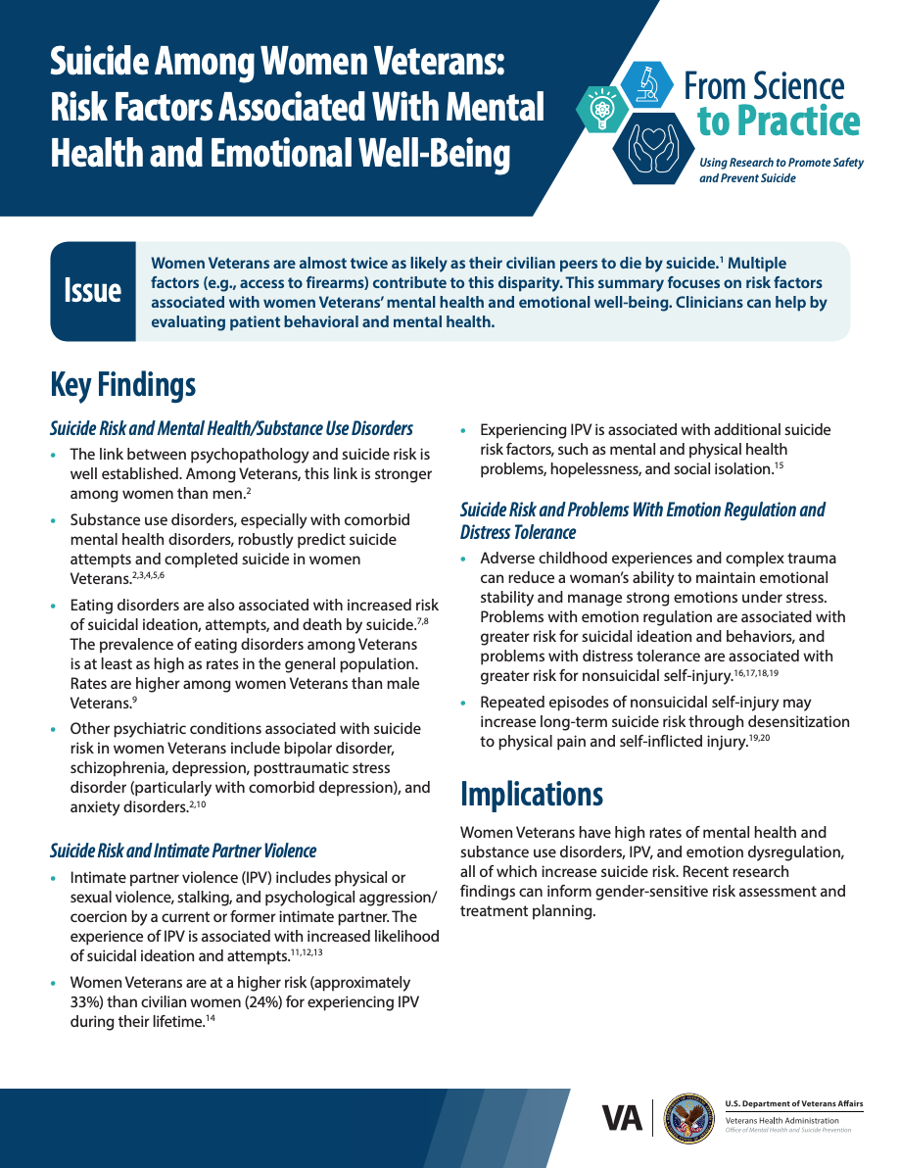
From Science to Practice
In 2019, VA launched a literature review series to help clinicians put suicide prevention research into action.
The series translates evidence-based research into informative and practical steps that health care providers can use to help support their Veteran patients.
The series is updated monthly.
Notes:
The “From Science to Practice” series describes a number of suicide risk and protective factors. No single risk or protective factor on its own causes or protects against suicide.

Slide 62
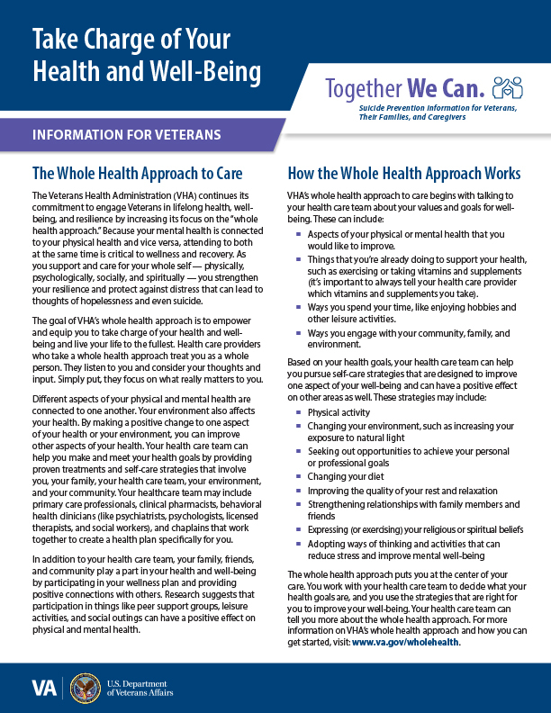
Together We Can
VA recently launched a new suicide prevention informational series for Veterans, their families and caregivers.
The series is backed by scientific findings designed to provide families and caregivers with resources and practical steps to take to Be There for Veterans in their lives.
Both series describe several suicide risk and protective factors.
https://www.mentalhealth.va.gov/suicide_prevention/resources.asp

Slide 63
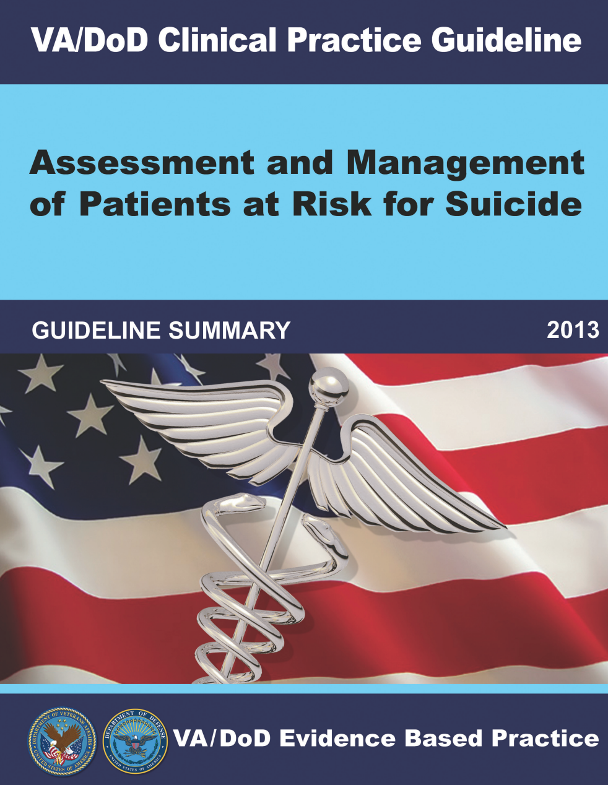
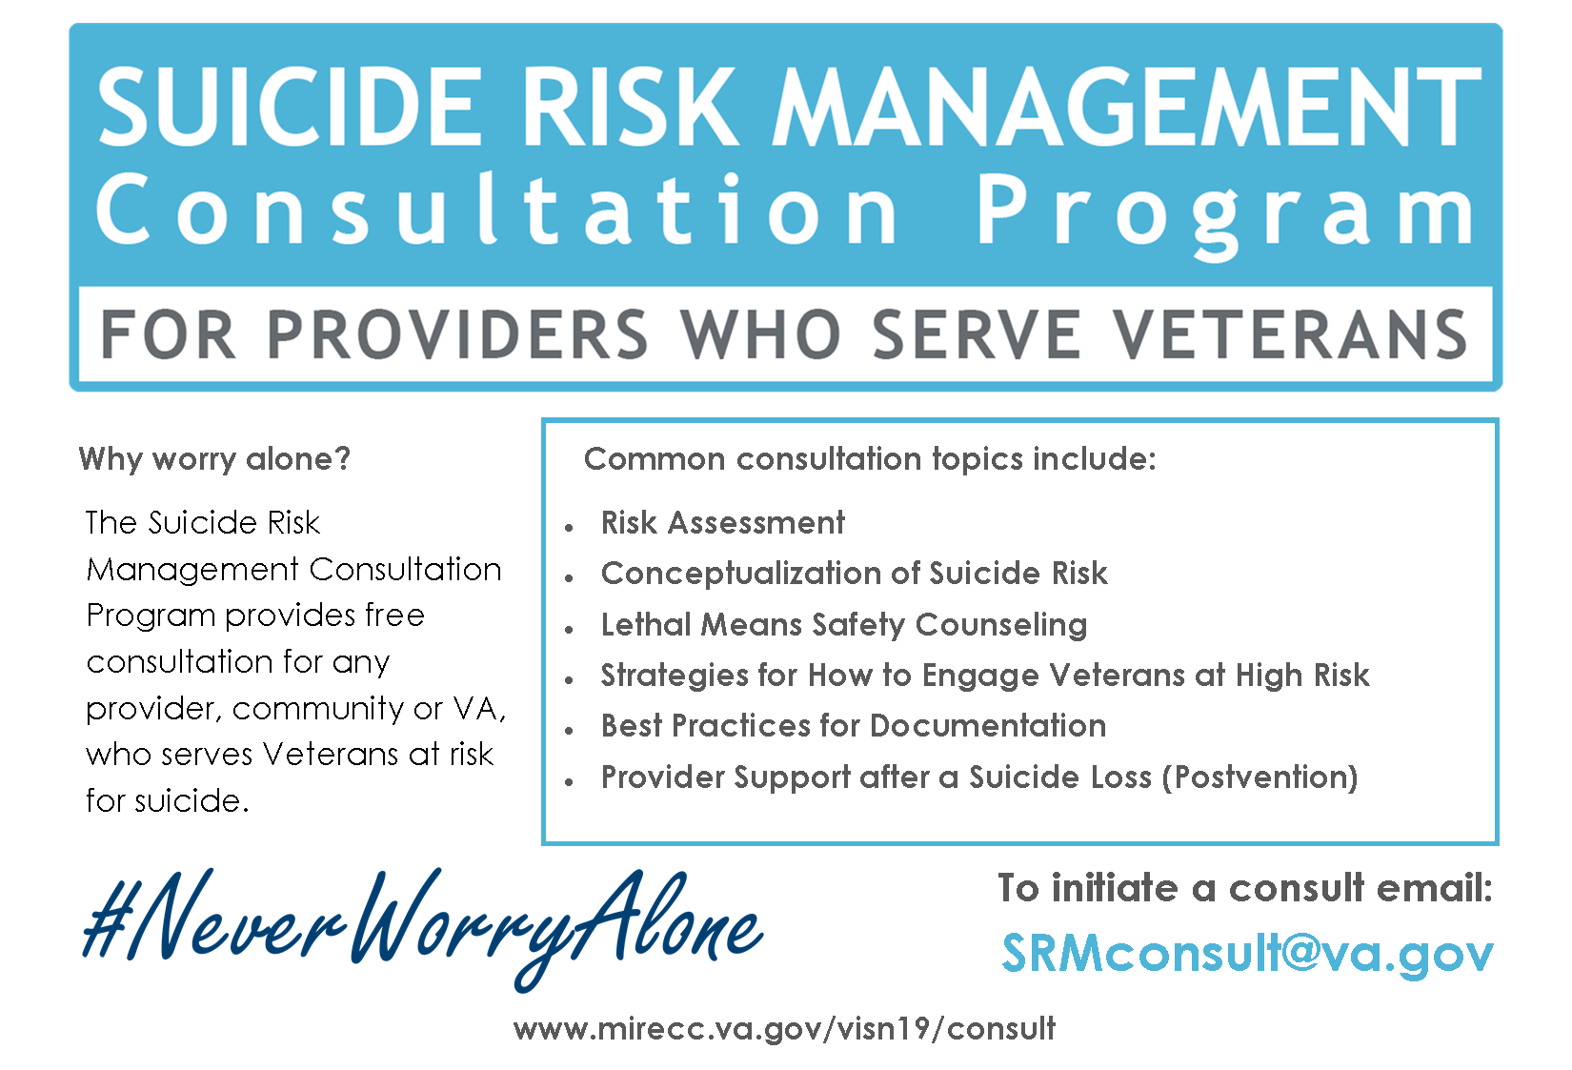
Resources for Clinicians
www.healthquality.va.gov/guidelines/MH/srb
Notes:
VA knows that local Veteran leaders know your populations best, and we cannot prevent suicide without local support.
Your voice and local expertise in reaching your peers, their families, and their caregivers in your community is invaluable.
Reaching Veterans where they live, work, and thrive requires collaborative community leaders like you.
You know the risk and protective factors of your community.
You know your community’s natural strengths and areas for improvement.
You know popular organizations in your area that may be open to suicide prevention partnerships.
You know your local data, research, and best practices.
We also know that local Veteran leaders create a sustainable future for Together with Veterans, so efforts can continue to be carried out by the community in the future.
We are grateful for your guidance and initiative in advancing our shared goal of suicide prevention and ability to generate impactful change.
The Suicide Prevention Program strives to equip leaders at different levels – and in different roles – with the ability to advance our shared goals. Please let me know if there is anything I can do to better support your efforts.

Slide 64
Stay Connected
Follow us on social media!
@deptvetaffairs
@veteransmtc
U.S. Department of Veterans Affairs
Veterans Health Administration
Make the Connection
@deptvetaffairs
@veteranshealth

Slide 65
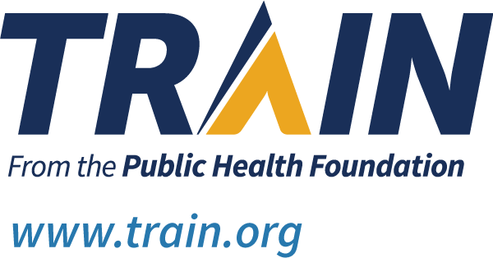
TRAIN Learning Network
TRAIN is a national learning network that provides quality training opportunities to over 1.8 million professionals who protect and improve the public's health.
Many of the trainings used for internal VA staff and clinicians are included on this public portal as an opportunity to train community providers.
The Suicide Prevention Program wants to ensure the high level of training provided to VA employees is also accessible to those assisting Veterans in their communities.
Notes:
TRAIN: TRAIN is a national learning network Public Health Foundation (PHF) that provides quality training opportunities to over 1.8 million professionals who protect and improve the public's health. More information is available at https://www.train.org/.
Suicide Prevention Courses: https://www.train.org/main/search?type=course&query=suicide

Slide 66
References
  Cerel J, Brown M, Maple M et al. How Many People Are Exposed to Suicide? Not Six. Suicide and Life-Threatening Behavior. 2018. doi:10.1111/sltb.12450
CDC. Web-based Injury Statistics Query and Reporting System (WISQARS). (2020) Atlanta, GA: National Center for Injury Prevention and Control. Retrieved from: https://www.cdc.gov/injury/wisqars/index.html
CDC. Violence Prevention Suicide Fast Fact: https://www.cdc.gov/violenceprevention/suicide/fastfact.html
Clyne, W., White, S., & McLachlan, S. (2012). Developing consensus-based policy solutions for medicines adherence for Europe: A Delphi study. BMC Health Services Research, 12(1), 425.
Isaac, M., Elias, B., Katz, L. Y., Belik, S. L., Deane, F.P., Enns, M.W., & Sareen, J. (2009). Gatekeeper training as a preventative intervention for suicide: A systematic review. The Canadian Journal of Psychiatry, 54(4), 260–268.
Knox, K. L., Pflanz, S., Talcott, G. W., Campise, R. L., Lavigne, J. E., Bajorska, A., Tu, X., & Caine, E. D. (2010). The US Air Force suicide prevention program: Implications for public health policy. American Journal of Public Health, 100(12), 2457-2463.

Slide 67
References
Knox, K. L., Litts, D. A., Talcott, G. W., Feig, J. C., & Caine, E. D. (2003). Risk of suicide and related adverse outcomes after exposure to a suicide prevention program in the US Air Force: Cohort study. British Medical Journal, 327(7428), 1376. doi: 10.1136/bmj.327.7428.1376.
Substance Abuse and Mental Health Services Administration. (2019) Key substance use and mental health indicators in the United States: Results from the 2018 National Survey on Drug Use and Health (HHS Publication No. PEP19-5068, NSDUH Series H-54). Rockville, MD: Center for Behavioral Health Statistics and Quality, Substance Abuse and Mental Health Services Administration. Retrieved from https://www.samhsa.gov/data/
U.S. Department of Veterans Affairs Office of Mental Health and Suicide Prevention. (2021) National Suicide Prevention Annual Report: 2021 National Veteran Suicide Prevention Annual Report (va.gov)

